Slide 1
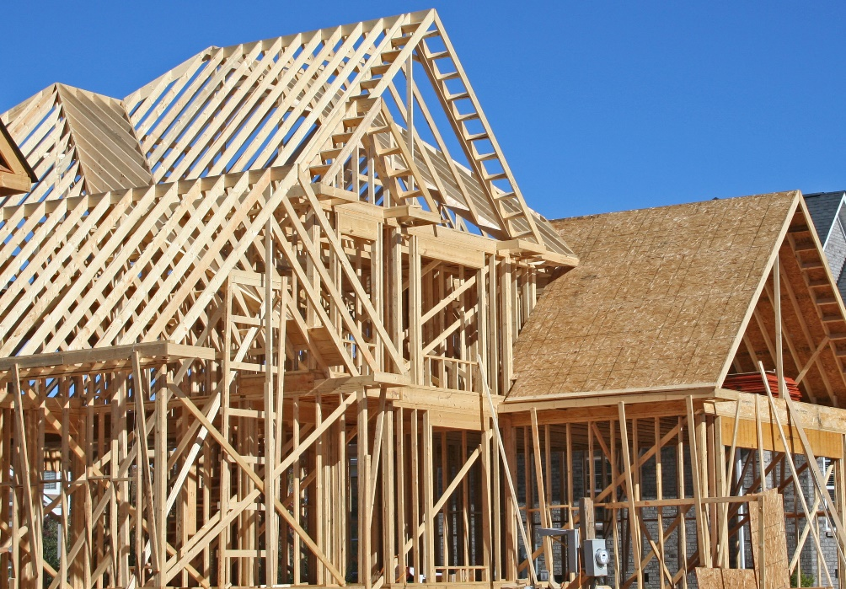
Divs and Spans
About
The <div> element
The <span> element
Pseudo Classes

Slide 2
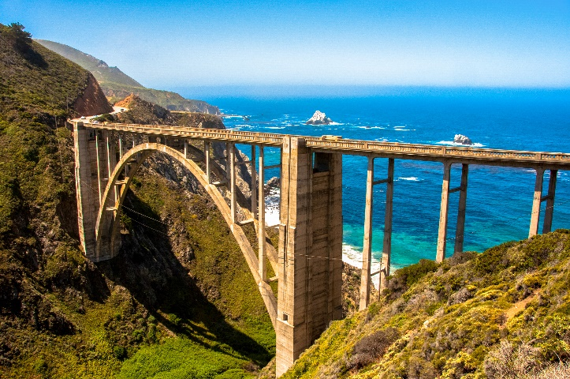
See Also
https://www.w3schools.com/html/html_blocks.asp
https://www.youtube.com/watch?v=GuUF1ZHEj_o

Slide 3
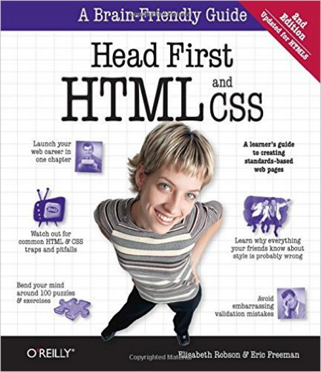
In the Book
Chapter 10:
Divs and Spans

Slide 4
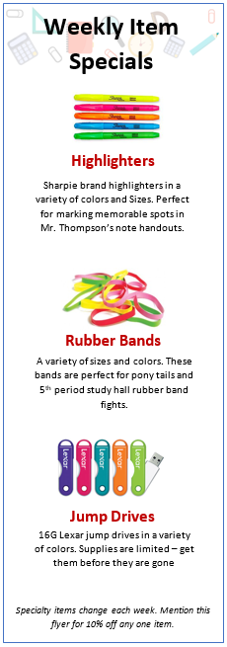
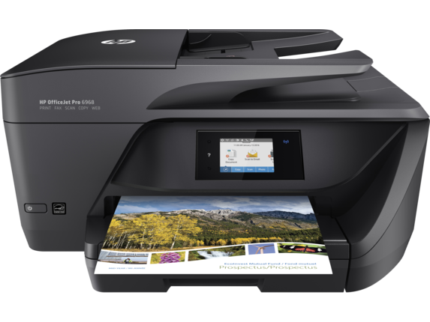
Sales Flyer
The Rusty Ruler has weekly specials
The team put a lot of work into a flyer
They would like to use the look on the website
Nice header
Images
Centered Text
Tall and slim
Footer

Slide 5

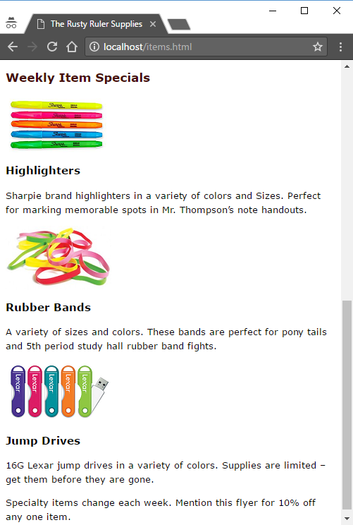
Item Flyer
items.html
Header
<h2>Weekly Item Specials</h2>
<p>
<img src="images/highlighter.png">
</p>
<h3>Highlighters</h3>
<p>Sharpie brand highlighters in a ...</p>
<p>
<img src="images/bands.png">
</p>
<h3>Rubber Bands</h3>
<p>A variety of sizes and colors ...</p>
<p>
<img src="images/drives.png">
</p>
<h3>Jump Drives</h3>
<p>16G Lexar jump drives in a ...</p>
<p>Specialty items change each week ...</p>
Item
Picture
Name
Description
Footer

Slide 6
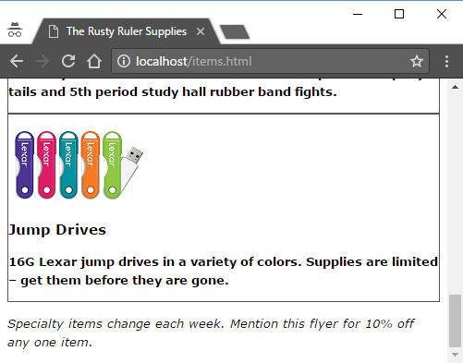
Grouping with <div>
<div id="header">
<h2>Weekly Item Specials</h2>
</div>
<div class="item">
<p>
<img src="images/highlighter.png">
</p>
<h3>Highlighters</h3>
<p>Sharpie brand highlighters in a ...</p>
</div>
<div class="item">
<p>
<img src="images/bands.png">
</p>
<h3>Rubber Bands</h3>
<p>A variety of sizes and colors ...</p>
</div>
<div id="footer">
<p>Specialty items change each week ...</p>
</div>
#footer p {
font-style: italic;
}
.item p {
font-weight: bold;
}
.item {
border-style: solid;
border-color: #555555;
border-width: 1px;
}

Slide 7
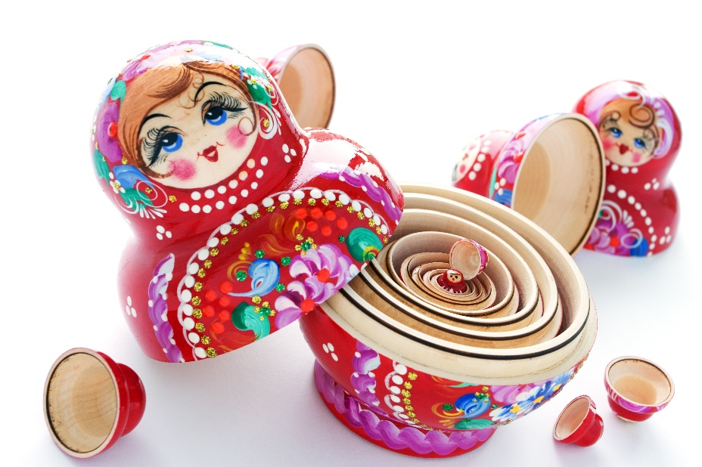
Nesting divs
<div class="specials">
<div class="weekly">
<div class="item">
<p>
<img src="images/highlighter.png">
</p>
<h3>Highlighters</h3>
<p>Sharpie brand ... </p>
</div>
</div>
</div>

Slide 8
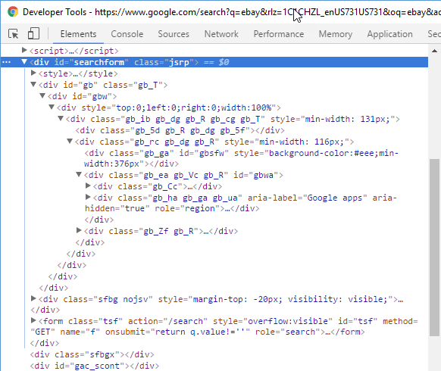
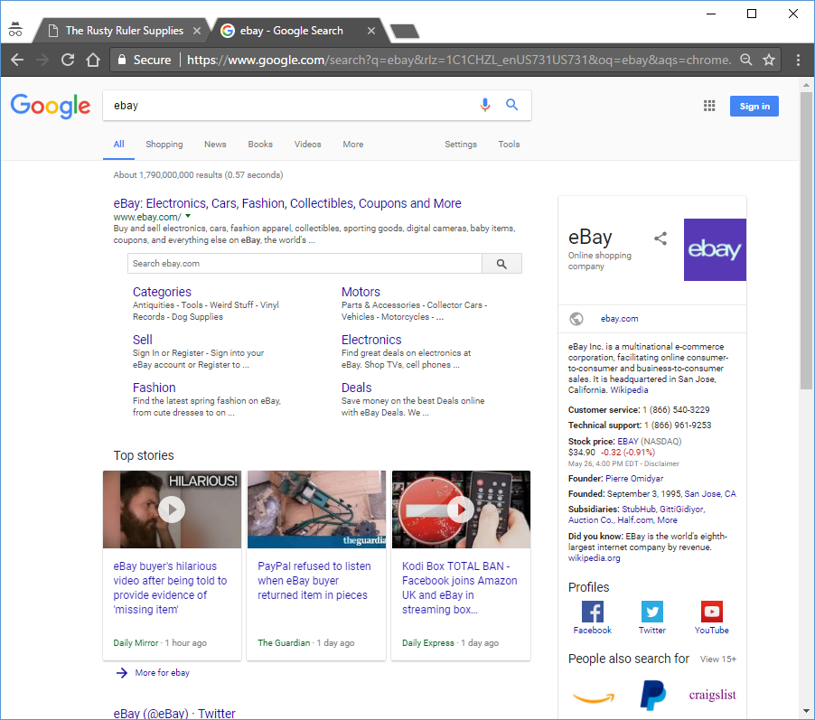
Nesting divs

Slide 9
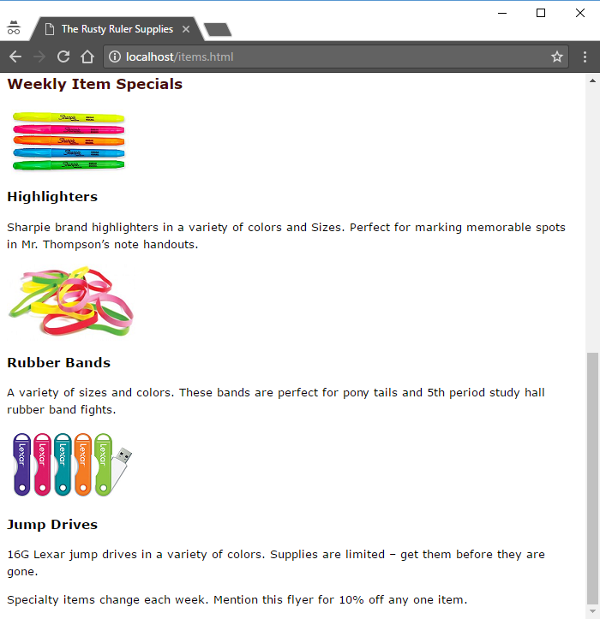
Styling the Flyer
Border
Background Image
Centered and padded
Narrow
Fonts, colors, line heights, etc.
Italics

Slide 10
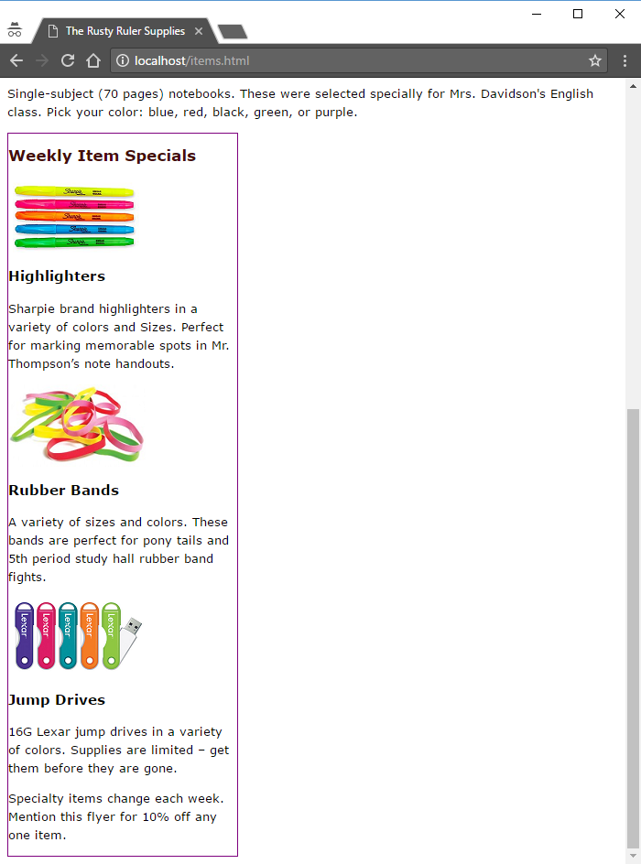
Width and Border
rusty.css
#flyer {
border-width: thin;
border-style: solid;
border-color: #7e4040;
width: 250px;
}
items.html
<div id="flyer">
<div id="header">
<h2>Weekly Item Specials</h2>
</div>
<div class="item">
<p>
<img src="images/highlighter.png">
</p>
<h3>Highlighters</h3>
<p>Sharpie brand highlighters in a ...</p>
</div>
<div id="footer">
<p>Specialty items change each week ...</p>
</div>
</div>
Width of the CONTENT area before padding, border, and margin.

Slide 11
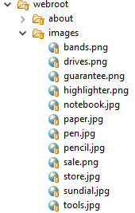
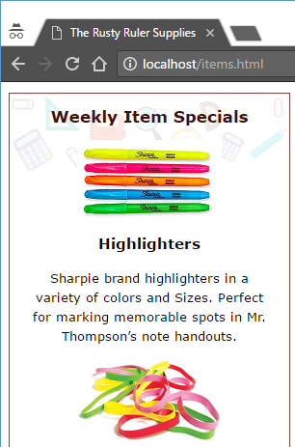
Basic Styling
rusty.css
20px + 250px + 20px
ALL inline elements … not just “test”.
#flyer {
border-width: thin;
border-style: solid;
border-color: #7e4040;
width: 250px;
padding-right: 20px;
padding-bottom: 20px;
padding-left: 20px;
text-align:center;
background-image: url(images/sale.png);
background-repeat: no-repeat;
}

Slide 12
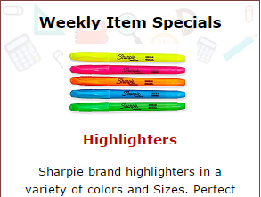
Selecting Descendants
items.html
rusty.css
<div id="flyer">
<div id="header">
<h2>Weekly Item Specials</h2>
</div>
<div class="item">
<p>
<img src="images/highlighter.png">
</p>
<h3>Highlighters</h3>
<p>Sharpie ...</p>
</div>
...
</div>
h2 {
color: black;
}
#flyer h2 {
color: black;
}
#header h2 {
color: black;
}
#flyer #header h2 {
color: black;
}
#flyer h3 {
color: #C00000;
}
.item h3 {
color: #C00000;
}
#flyer .item h3 {
color: #C00000;
}
My first thought

Slide 13
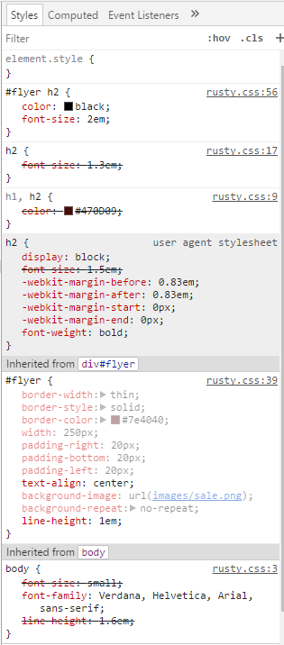
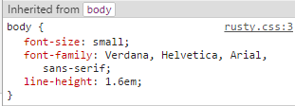
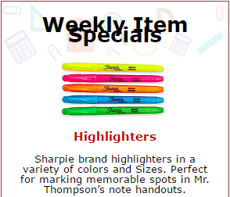
Line Height
Too much
#flyer {
...
line-height: 1em;
}
#flyer h2 {
color: black;
font-size: 2em;
}

Slide 14
Line Height
#flyer {
...
line-height: 1em;
}
#flyer h2 {
color: black;
font-size: 2em;
}
Values with units (em, px, %) are fixed values
<p>
font-size: 1em;
line-height: 1em;
<h2>
font-size: 2em;
line-height: 1em;

Slide 15
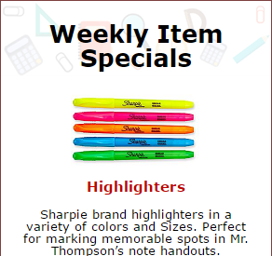
Line Height
#flyer {
...
line-height: 1;
}
#flyer h2 {
color: black;
font-size: 2em;
}
No Units
Special feature of “line-height”
Elements multiply by their own font size
(Not a fixed value here)
<p>
font-size: 1em;
line-height: 1em * 1 = 1em;
<h2>
font-size: 2em;
line-height: 2em * 1 = 2em;

Slide 16
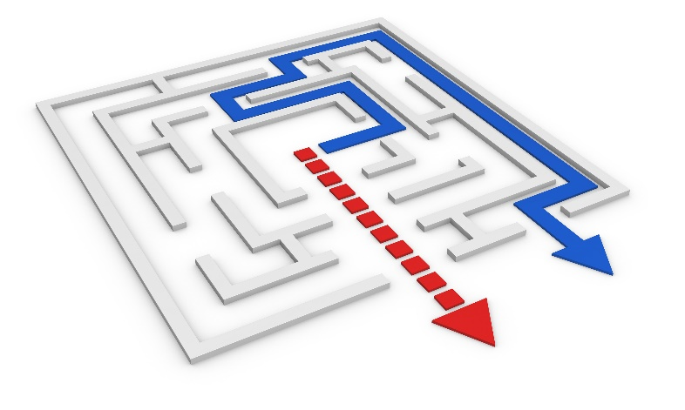
Shortcuts
padding-top: 10px;
padding-right: 20px;
padding-bottom: 30px;
padding-left: 40px;
top
right
bottom
left
padding: 10px 20px 30px 40px;
top
right
bottom
padding: 10px 20px 30px;
left=right
margin:
top
right
left=right
padding: 10px 20px;
bottom=top
padding: 10px;
All the same
Notes:
Can punt this if time is short

Slide 17
Shortcuts
border-width: thin;
border-style: solid;
border-color: black;
background-color: white;
background-image: url(...);
background-repeat: repeat-x;
width
style
color
color
image
repeat
border: thin solid black;
background: white url(…) repeat-x;
font: style variant weight size/height family,
style variant weight size/height family;
font: italic small-caps bold small/1.6em Verdana;
Notes:
Can punt this if time is short

Slide 18

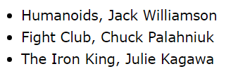
Spans
<ul>
<li>Humanoids, Jack Williamson</li>
<li>Fight Club, Chuck Palahniuk</li>
<li>The Iron King, Julie Kagawa</li>
</ul>

Slide 19
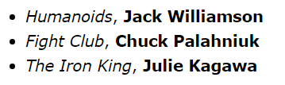
Spans
<span class="book">Humanoids</span>
Inline Element
<ul>
<li><span class="book">Humanoids</span>, <span class="author">Jack Williamson</span></li>
<li><span class="book">Fight Club</span>, <span class="author">Chuck Palahniuk</span></li>
<li><span class="book">The Iron King</span>, <span class="author">Julie Kagawa</span></li>
</ul>
.book {
font-style: italic;
}
.author {
font-weight: bold;
}

Slide 20
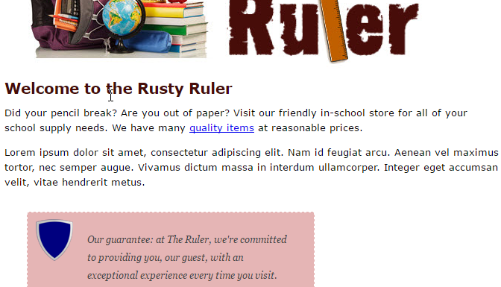
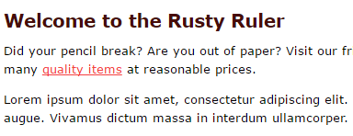
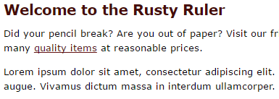
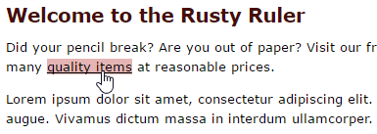
State Selectors
a:link {
color: #f54040;
}
a:visited {
color: #601010;
}
a:hover {
color:black;
background-color: #e5b5b5;
}

Slide 21
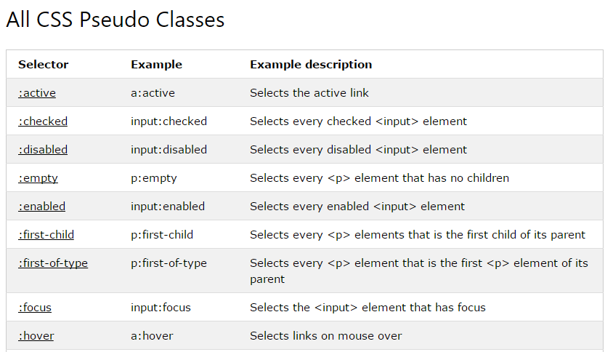
Pseudo Classes
https://www.w3schools.com/css/css_pseudo_classes.asp

Slide 22
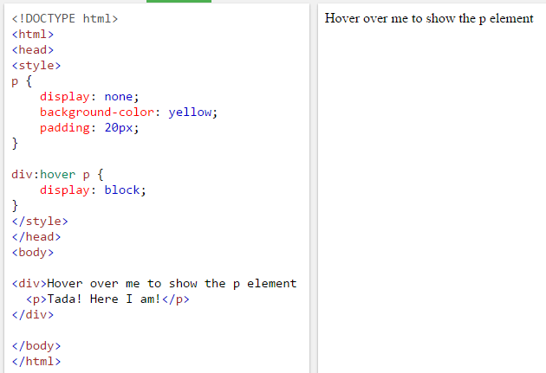
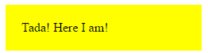
Pseudo Classes

Slide 23
Cascade
BROWSER
corp.css
...
h1 {color:black;}
...
...
h1.blueberry {color: blue;}
...
...
Find all the rules that apply to the element
rusty.css
h1.rusty {color: gray;}
...
READER
corp.css
body h1 {color:red};
h1 {color:green;}
<h1 id="top" class="rusty blueberry cape">...</h1>

Slide 24
Cascade
corp.css
h1.blueberry {color: blue;}
Sort them: Author, Reader, Browser
AUTHOR: Highest Preference
corp.css
h1 {color:green;}
rusty.css
h1.rusty {color: gray;}
You have no control over the user’s settings – don’t worry about them
Only keep the set of highest preference
READER settings
READER
body h1 {color:red};
BROWSER: Lowest Preference
BROWSER
h1 {color:black;}

Slide 25
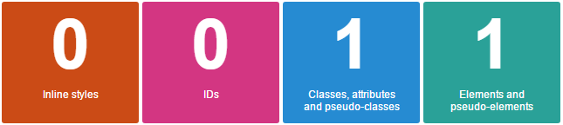
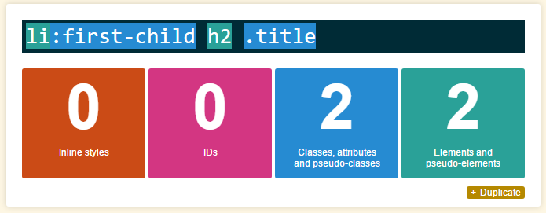
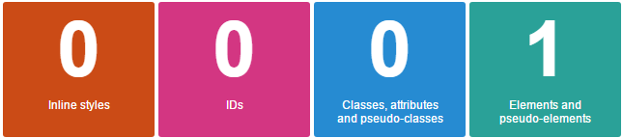
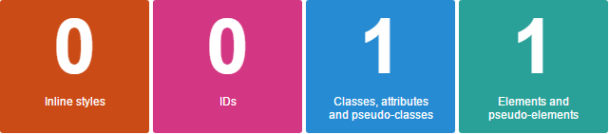
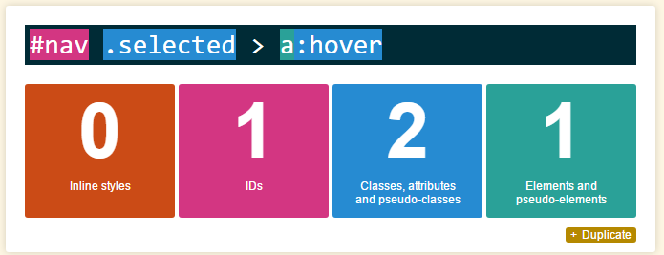
Specificity
https://specificity.keegan.st/
Calculate Specificity
corp.css
h1.blueberry {color: blue;}
corp.css
h1 {color:green;}
rusty.css
h1.rusty {color: gray;}
Keep highest number(s)

Slide 26
Last Specified
Winner is the LAST rule loaded
corp.css
index.html
h1.blueberry {color: blue;}
<head>
<title>The Rusty Ruler</title>
<link href="bootstrap.min.css">
<link href="school.css">
<link href="corp.css">
<link href="rusty.css">
</head>
rusty.css
h1.rusty {color: gray;}

Slide 27

Tinkering
Finish the footer in the web flyer:
Small, italic font
Less spacing on left and right
Use the specificity calculator to find the values of all rules in rusty.css.

